Slide 1


Bank Loan Case Study trainity Project#6
By:
Anurag Changmai
Data Analytics Trainee

Slide 2
Project Description
Providing lines of credit is important among the many functions a bank serves. Banks use various instruments to do so, of which loans are some of the most significant. Extending loans is based on multiple conditions, but an implicit trust in the lender’s ability to lend and the lendee’s ability to repay is primary.
In this project, I analyze a sample dataset of bank loan applications. In doing so, I try to derive insights into applicant behavior and characteristics, and their correlation to the success of their applications. The aim is to understand what type of applicant has a higher chance of receiving loan approval, and, in turn, is the sign of a profitable relationship for the bank.

Slide 3
Approach
This project begins by first obtaining a sample dataset of bank loan applications. This dataset carries information for almost 50000 applicants, with parameters such as application status, loan type, amount requested, occupational details, etc.
This data is then cleaned before being used, and outliers are noted to ensure all data points are taken into consideration. For better clarity, data is represented in a tabular form and a chart form wherever possible.

Slide 4
Tech-stack used
In the execution of this project, the following software was used:
1. Microsoft Excel 2019 v2307
→ It was used to understand the data, which was in XLSX format, clean it, filter it, obtain results from it, and display the same in tabular and chart forms.

Slide 5
Insights
Over the following slides, I will try to obtain insights on:
Missing data and outliers
Data imbalance
Univariate analysis
Segmented univariate analysis
Bivariate analysis
Correlations for different scenarios

Slide 6
Cleaning the data
Before diving into the data to obtain insights, I had to clean the data and make it ready for analysis. The following steps were performed during the data-cleaning process:
Rows numbering from A50001 to DR307512 were deleted as they had no corresponding SK_ID_CURR
Created 2 new columns:
YEARS_BIRTH from DAYS_BIRTH using formula =ROUND(ABS(R2:R50000),2)
YEARS_EMPLOYED from DAYS_EMPLOYED using formula =ROUND(ABS(T2:T50000),2)
The columns in the next slide were removed from the sample dataset as they were deemed insignificant in my analysis process:

Slide 7
Cleaning the data (Cont.)
FLAG_DOC_2 to FLAG_DOC_21, FLAG_MOBIL, FLAG_EMP_PHONE, FLAG_WORK_PHONE, FLAG_CONT_MOBILE, FLAG_PHONE, FLAG_EMAIL, REG_REGION_NOT_LIVE_REGION, REG_REGION_NOT_WORK_REGION, LIVE_REGION_NOT_WORK_REGION, REG_CITY_NOT_LIVE_CITY, REG_CITY_NOT_WORK_CITY, LIVE_CITY_NOT_WORK_CITY, EXT_SOURCE_1 to EXT_SOURCE_3, APARTMENTS_AVG, BASEMENTAREA_AVG, YEARS_BEGINEXPLUATATION_AVG, YEARS_BUILD_AVG, COMMONAREA_AVG, ELEVATORS_AVG, ENTRANCES_AVG, FLOORSMAX_AVG, FLOORSMIN_AVG, LANDAREA_AVG, LIVINGAPARTMENTS_AVG, LIVINGAREA_AVG, NONLIVINGAPARTMENTS_AVG, NONLIVINGAREA_AVG, APARTMENTS_MODE, BASEMENTAREA_MODE, YEARS_BEGINEXPLUATATION_MODE, YEARS_BUILD_MODE, COMMONAREA_MODE, ELEVATORS_MODE, ENTRANCES_MODE, FLOORSMAX_MODE, FLOORSMIN_MODE, LANDAREA_MODE, LIVINGAPARTMENTS_MODE, LIVINGAREA_MODE, NONLIVINGAPARTMENTS_MODE, NONLIVINGAREA_MODE, APARTMENTS_MEDI, BASEMENTAREA_MEDI, YEARS_BEGINEXPLUATATION_MEDI, YEARS_BUILD_MEDI, COMMONAREA_MEDI, ELEVATORS_MEDI, ENTRANCES_MEDI, FLOORSMAX_MEDI, FLOORSMIN_MEDI, LANDAREA_MEDI, LIVINGAPARTMENTS_MEDI, LIVINGAREA_MEDI, NONLIVINGAPARTMENTS_MEDI, NONLIVINGAREA_MEDI, HOUSETYPE_MODE, TOTALAREA_MODE, WALLSMATERIAL_MODE, EMERGENCYSTATE_MODE, OBS_30_CNT_SOCIAL_CIRCLE, DEF_30_CNT_SOCIAL_CIRCLE, OBS_60_CNT_SOCIAL_CIRCLE, DEF_60_CNT_SOCIAL_CIRCLE, DAYS_LAST_PHONE_CHANGE, AMT_REQ_CREDIT_BUREAU_HOUR, AMT_REQ_CREDIT_BUREAU_DAY, AMT_REQ_CREDIT_BUREAU_WEEK, DAYS_REGISTRATION, DAYS_ID_PUBLISH, OWN_CAR_AGE, HOUR_APPR_PROCESS_START, FONDKAPREMONT_MODE

Slide 8
Dealing with missing data
Blank cells were found in the following categories with the accompanying counts:
Other than NAME_TYPE_SUITE and OCCUPATION_TYPE, all other blanks were replaced by median values from respective columns.
Column name | Count of blanks
AMT_ANNUITY | 1
AMT_GOODS_PRICE | 38
NAME_TYPE_SUITE | 192
OCCUPATION_TYPE | 15654
CNT_FAM_MEMBERS | 1
AMT_REQ_CREDIT_BUREAU_MON | 6734
AMT_REQ_CREDIT_BUREAU_QRT | 6734
AMT_REQ_CREDIT_BUREAU_YEAR | 6734

Slide 9



Dealing with missing data (Cont.)
The images below show the no. of blanks in each column, followed by the median value of that column. This median value was used to fill the blanks.

Slide 10


Dealing with missing data (Cont.)
For NAME_TYPE_SUITE and OCCUPATION_TYPE, I replaced the blanks with the most recurring value. To find this value, I obtained the counts of different values in each category and plotted them for visual representation, as shown in the subsequent slides. The value with the highest recurrence was then used to fill the blanks.
The count of blanks for both categories is given below:

Slide 11
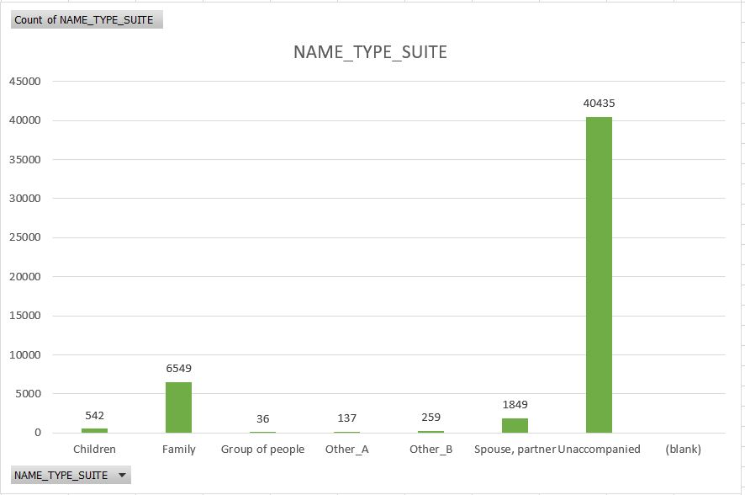
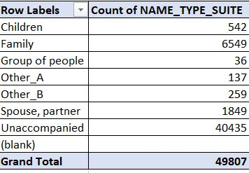
Dealing with missing data (Cont.)
The pivot table below shows the count of all values, including blanks, in NAME_TYPE_SUITE, which is visually represented in the column graph on the right. The value ‘Unaccompanied’ has the highest recurrence.

Slide 12
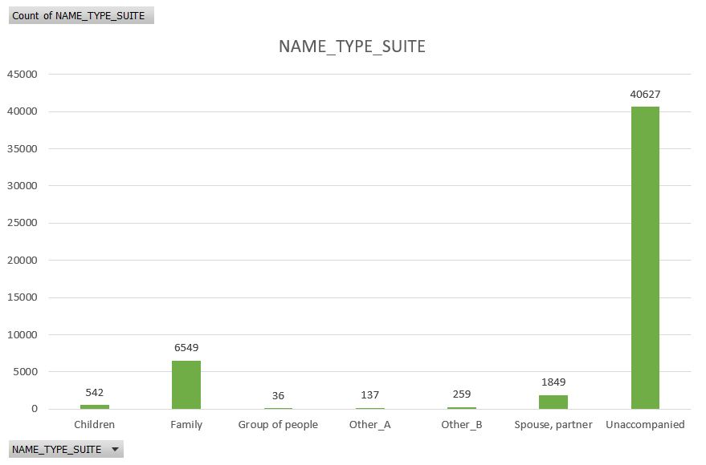
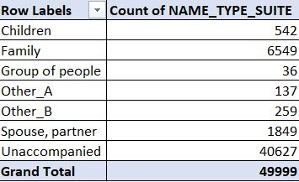
Dealing with missing data (Cont.)
The pivot table below shows the count of all values, without blanks, in NAME_TYPE_SUITE, which is visually represented in the column graph on the right. The blanks were replaced with the value ‘Unaccompanied’.

Slide 13
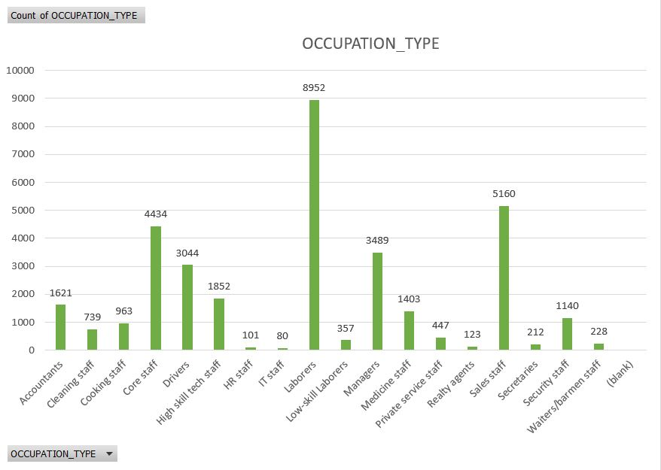
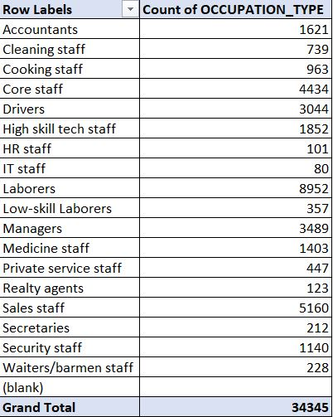
Dealing with missing data (Cont.)
The pivot table below shows the count of all values, including blanks, in OCCUPATION_TYPE, which is visually represented in the column graph on the right. The value ‘Laborers’ has the highest recurrence.

Slide 14
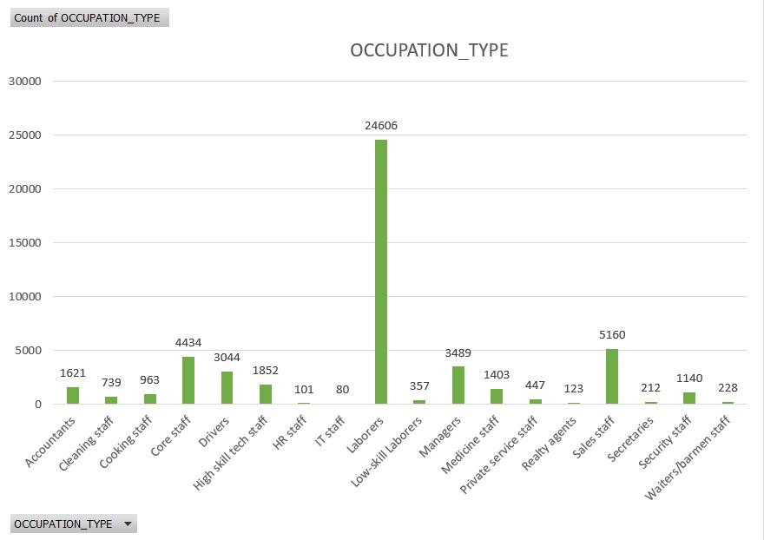
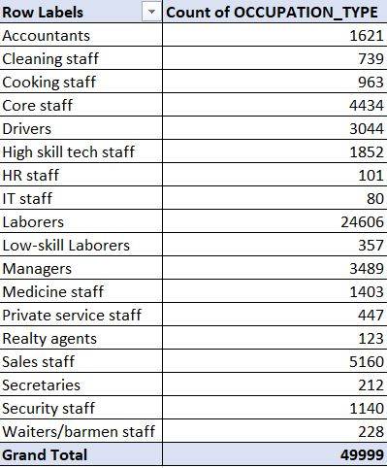
Dealing with missing data (Cont.)
The pivot table below shows the count of all values, without blanks, in OCCUPATION_TYPE, which is visually represented in the column graph on the right. The blanks were replaced with the value ‘Laborers’.

Slide 15
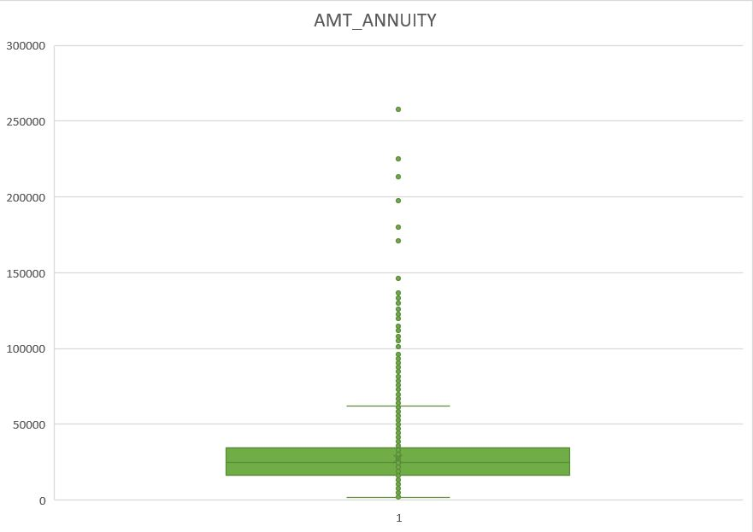
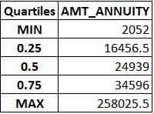
Handling outliers
Outliers were first found in the AMT_ANNUITY field. However, these outliers were not removed as the loan amount varies from person to person, which in turn varies the annuity amount.

Slide 16
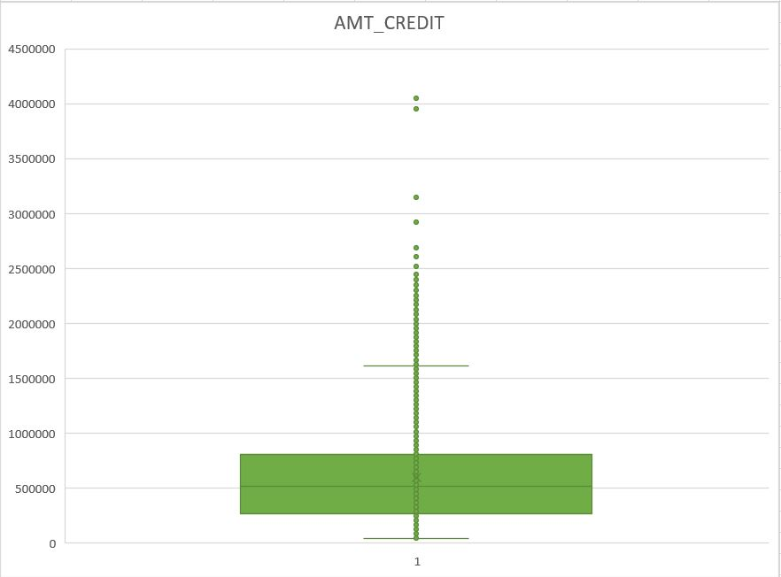
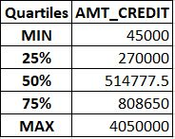
Handling outliers (Cont.)
Outliers were then found in the AMT_CREDIT field. These outliers also were not removed as the loan amount varies from person to person.

Slide 17
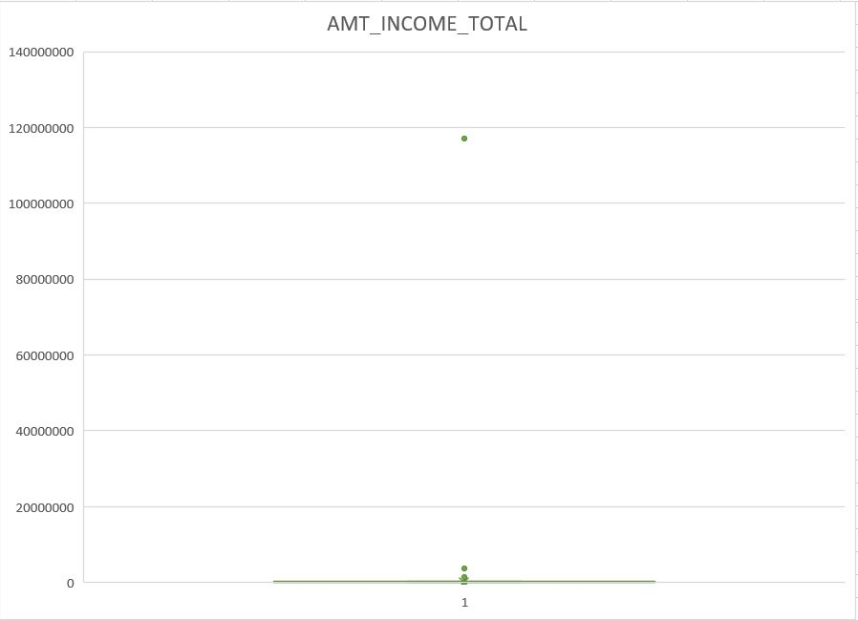
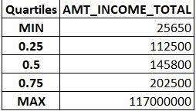
Handling outliers (Cont.)
Next, outliers were found in the AMT_INCOME_TOTAL field. These outliers also were not removed as the income varies from person to person.

Slide 18
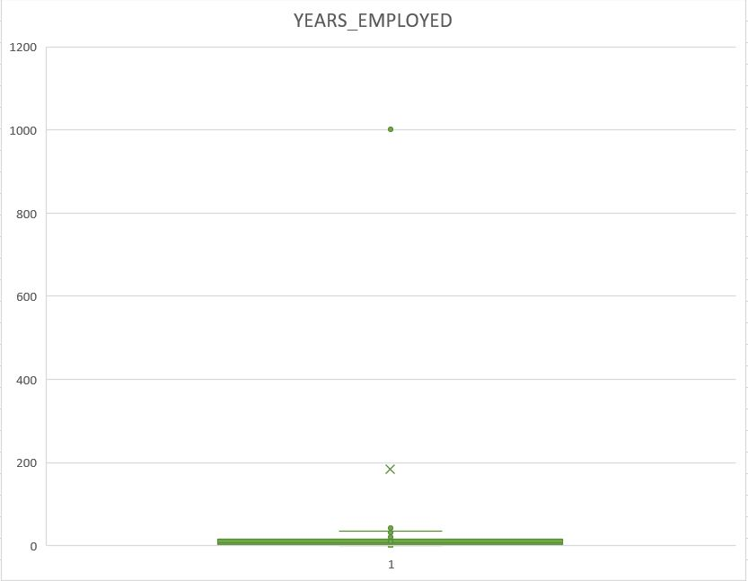
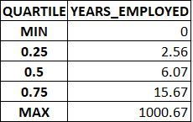
Handling outliers (Cont.)
Finally, outliers were found in the YEARS_EMPLOYED field. These outliers had to be removed as the no. of years a person has been employed for could not be 1000.67.

Slide 19
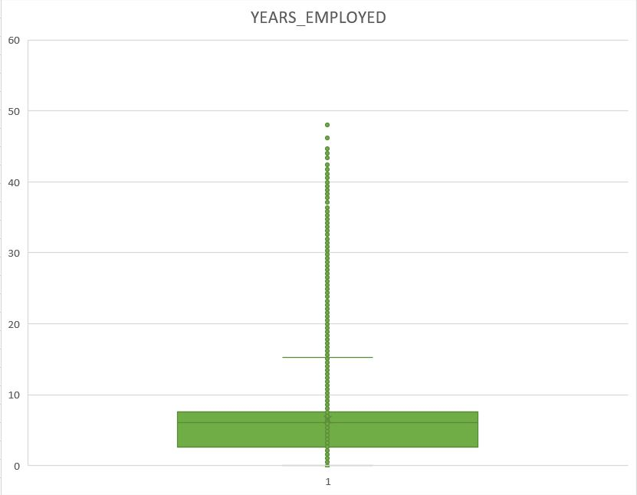

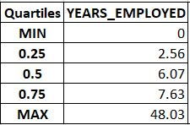
Handling outliers (Cont.)
To remove the outlier, I took the median value, which was 6.07 years, and replaced all outlying values with this number. The final distribution is seen above.

Slide 20
Analyzing data imbalance
Data imbalance occurs when the sample data contains a disproportionate ratio of samples in each class/field. It is a frequent occurrence in data derived from the real world. However, it can affect the accuracy of the resultant information, which is why identifying it is essential in analyzing any dataset.
In the following slides, the data imbalance seen in my dataset is shown graphically to better understand the amount of skew in certain fields.

Slide 21
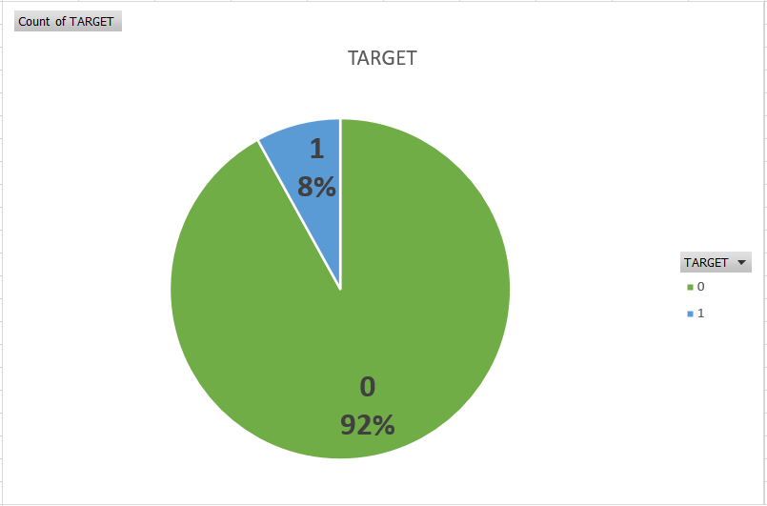

Analyzing data imbalance (Cont.)
The above pie chart shows the TARGET field, which represents the approval status of loan applications. Here, only 8% of applications are in the ‘1’ category, which means rejected. This means, 92% of the loan applications are approved (‘0’ category).

Slide 22
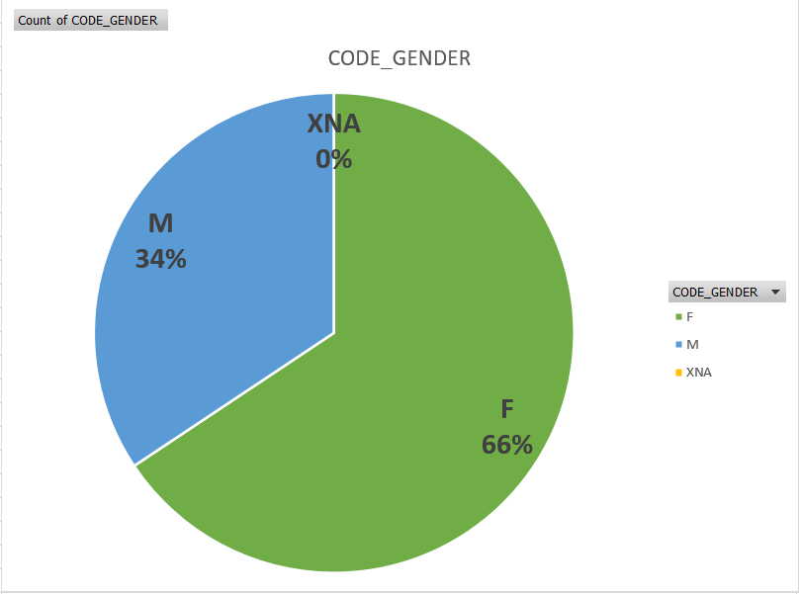
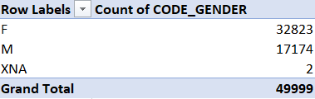
Analyzing data imbalance (Cont.)
The above pie chart shows the CODE_GENDER field, which represents the gender of loan applicants. Here, only 34% of applicants are Male, while 66% are Female.

Slide 23
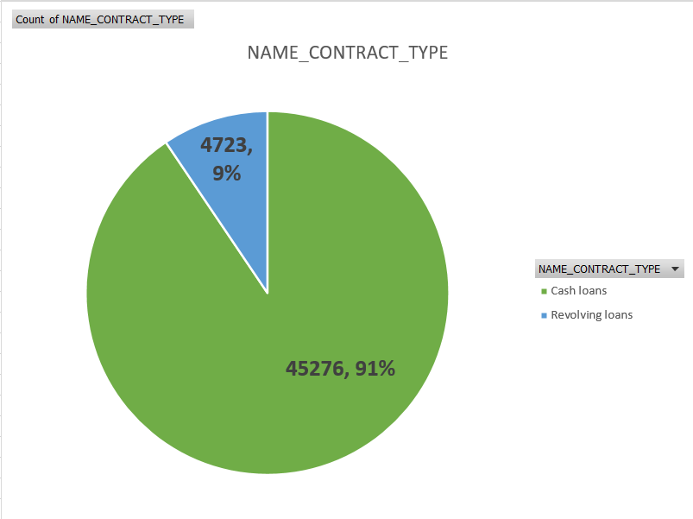

Analyzing data imbalance (Cont.)
The above pie chart shows the NAME_CONTRACT_TYPE field, which represents the type of loans requested. Here, only 9% of applications are for Revolving loans, while 91% are for Cash loans.

Slide 24
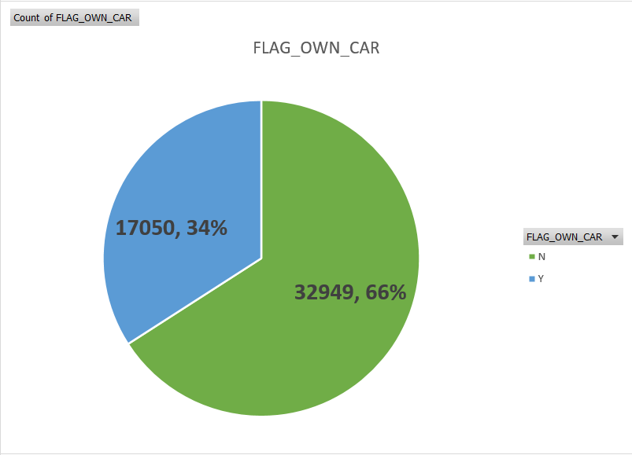

Analyzing data imbalance (Cont.)
The above pie chart shows the FLAG_OWN_CAR field, which represents car owners among the loan applicants. Here, only 34% of the applicants owned a car, while the remaining 66% did not.

Slide 25
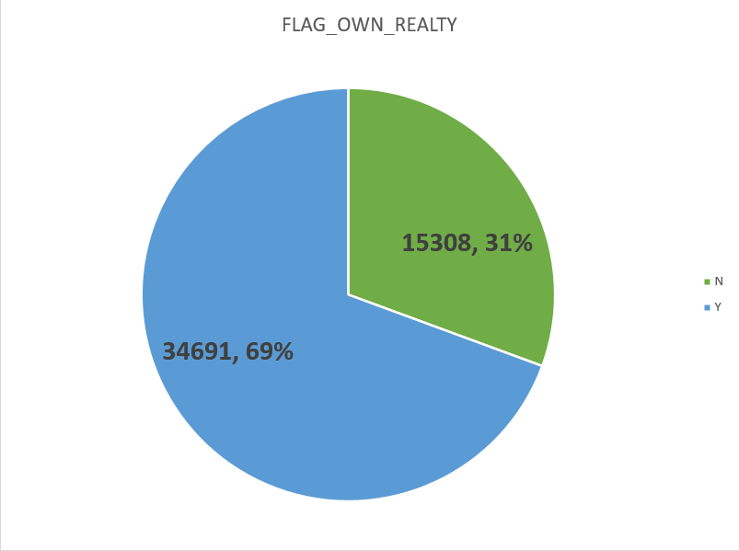

Analyzing data imbalance (Cont.)
The above pie chart shows the FLAG_OWN_REALTY field, which represents house/flat owners among the loan applicants. Here, 69% of the applicants owned a house/flat, while the remaining 31% did not.

Slide 26
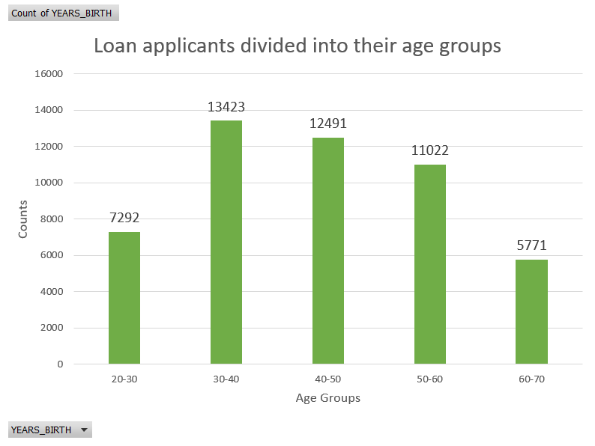
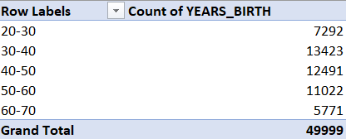
Performing univariate analysis
In the above column graph and pivot table, the loan applicants are divided into their age groups. It can be seen that most loan applications are from people in the age group 30-40.

Slide 27
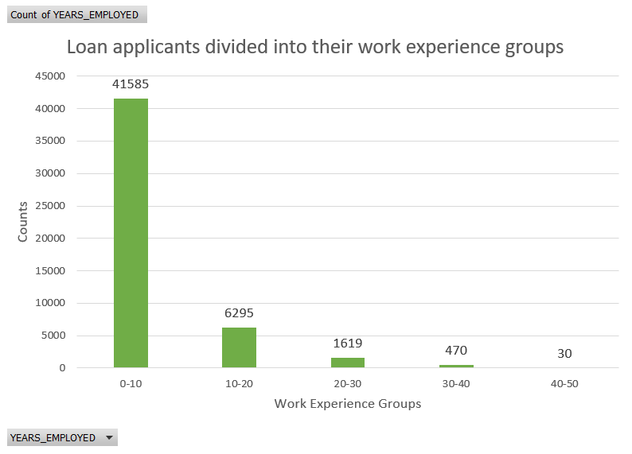
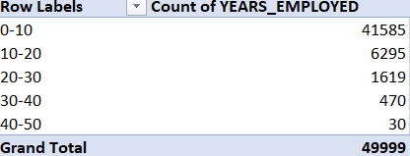
Performing univariate analysis (Cont.)
In the above column graph and pivot table, the loan applicants are divided into their work experience groups. It can be seen that most loan applications are from people who have work experience in the 0-10 years range.

Slide 28
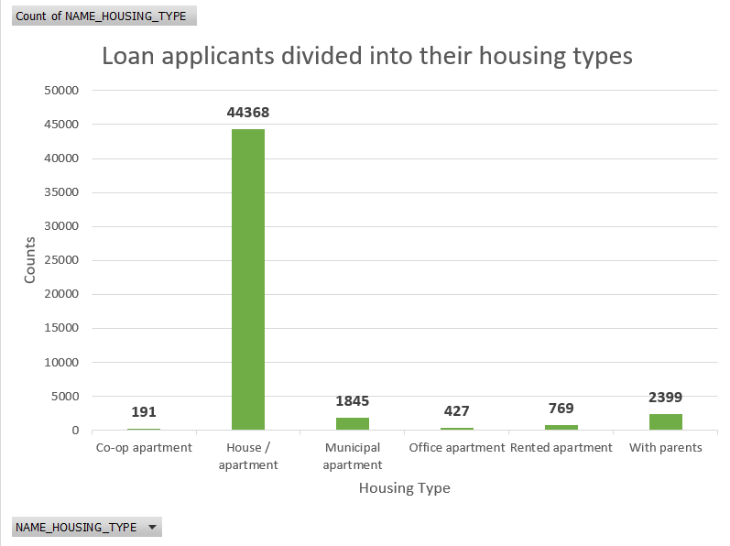
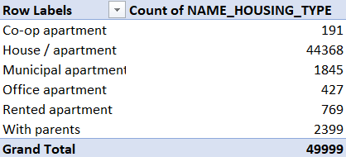
Performing univariate analysis (Cont.)
In the above column graph and pivot table, the loan applicants are divided into their housing types. It can be seen that most loan applications are from people who live in houses/apartments.

Slide 29
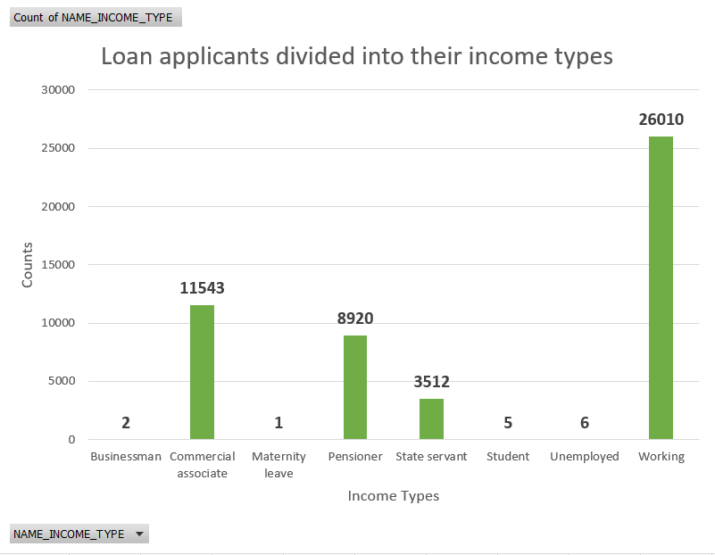
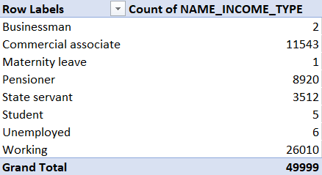
Performing univariate analysis (Cont.)
In the above column graph and pivot table, the loan applicants are divided into their income types. It can be seen that most loan applicants have Working income types.

Slide 30
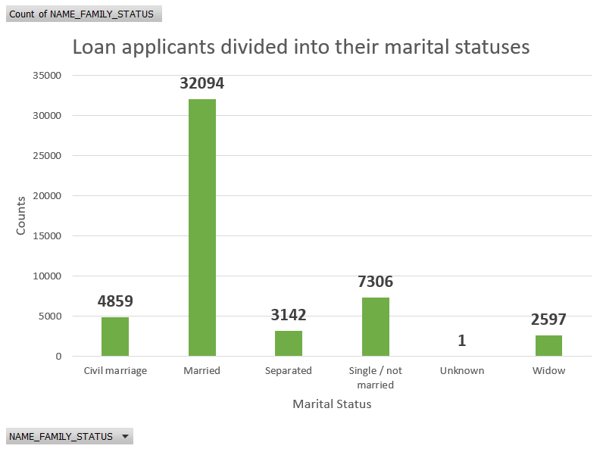
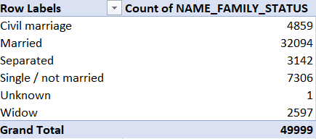
Performing univariate analysis (Cont.)
In the above column graph and pivot table, the loan applicants are divided into their marital statuses. It can be seen that most loan applicants are Married.

Slide 31
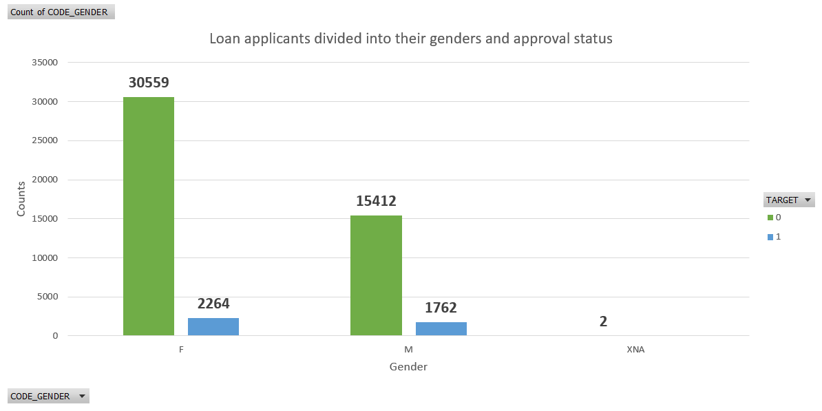
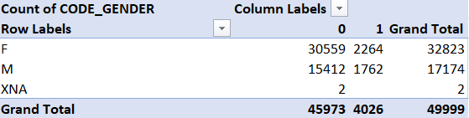
Performing segmented univariate analysis
In the above column graph and pivot table, the loan applicants are divided into their genders and loan approval status. It can be seen that Male loan applicants face the most rejections at 11.43%.

Slide 32
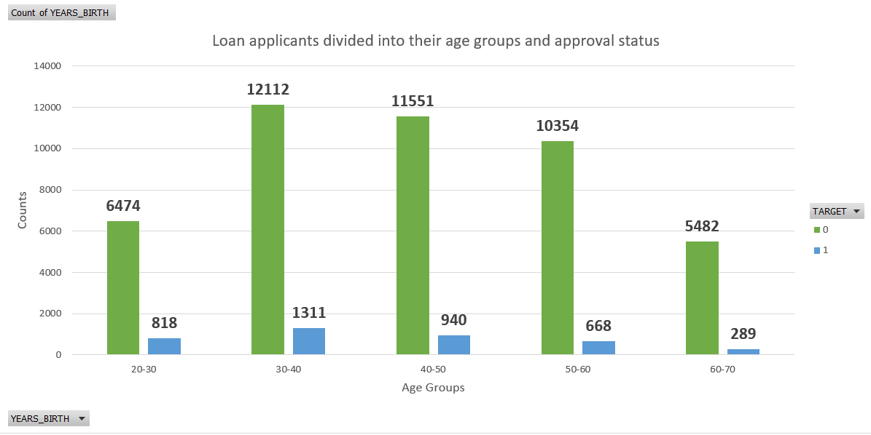
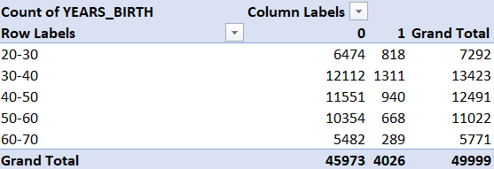
Performing segmented univariate analysis (Cont.)
In the above column graph and pivot table, the loan applicants are divided into their age groups and loan approval status. It can be seen that loan applicants belonging to the age group of 20-30 face the most rejections at 12.63%.

Slide 33
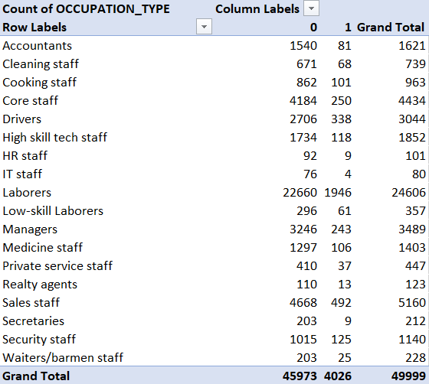
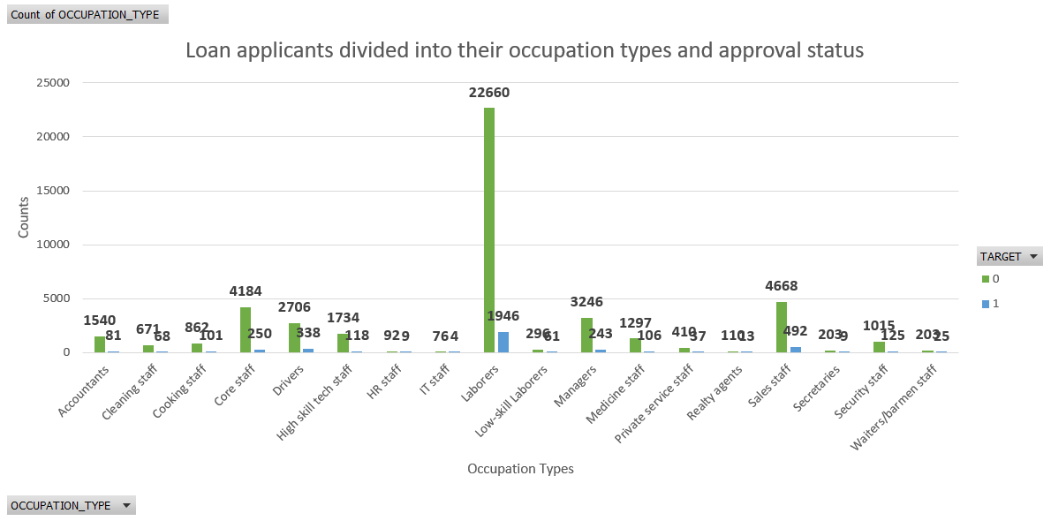
Performing segmented univariate analysis (Cont.)
In the above column graph and pivot table, the loan applicants are divided into their occupation types and loan approval status. It can be seen that loan applicants belonging to the Low-skill Laborers occupation type face the most rejections at 20.6%.

Slide 34
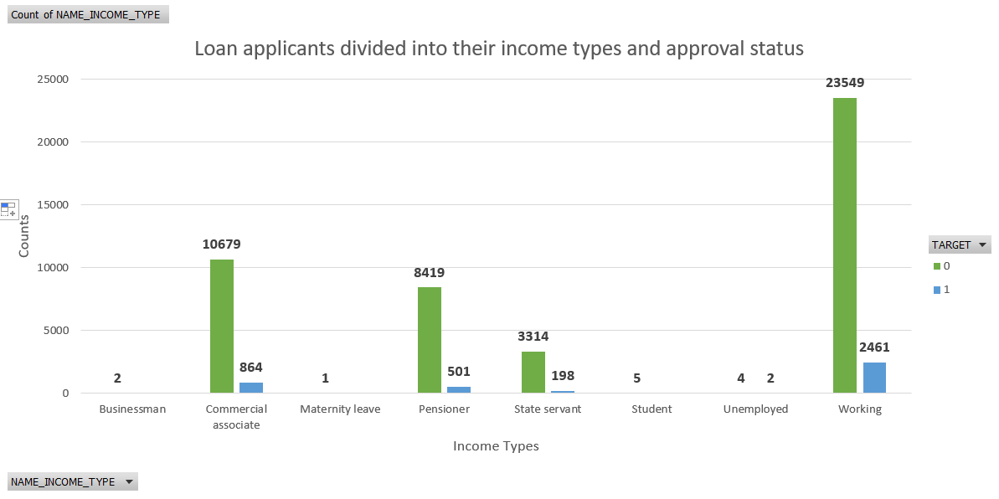
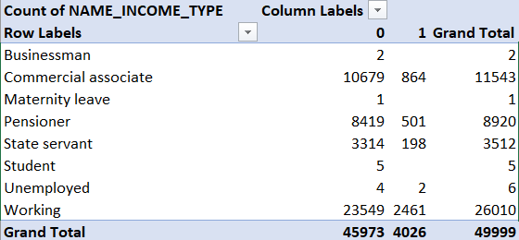
Performing segmented univariate analysis (Cont.)
In the above column graph and pivot table, the loan applicants are divided into their income types and loan approval status. It can be seen that loan applicants belonging to the Working income type face the most rejections at 10.45%.

Slide 35
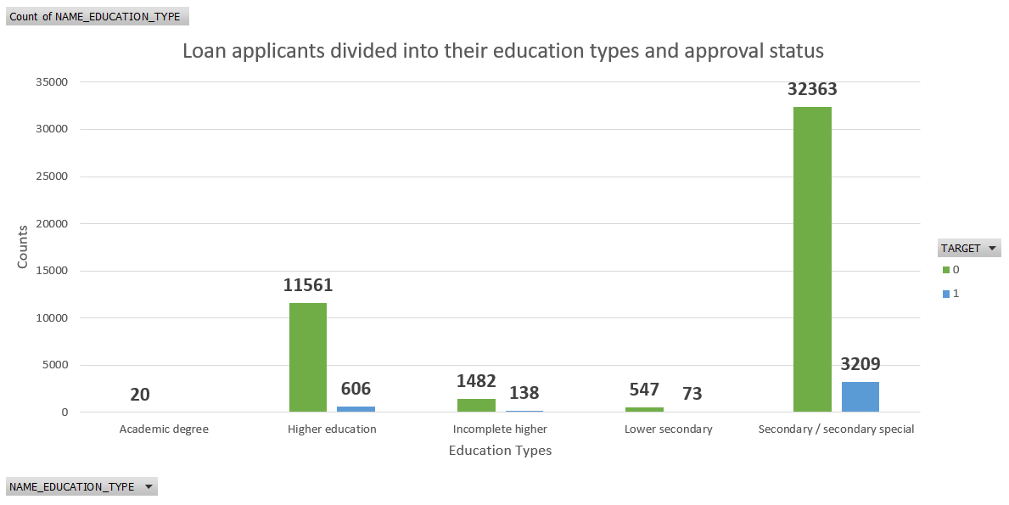
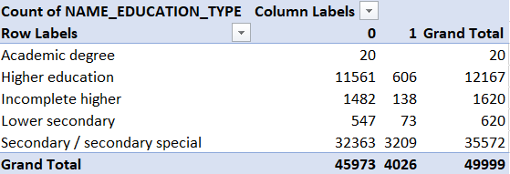
Performing segmented univariate analysis (Cont.)
In the above column graph and pivot table, the loan applicants are divided into their education types and loan approval status. It can be seen that loan applicants belonging to the Lower secondary education type face the most rejections at 13.34%.

Slide 36
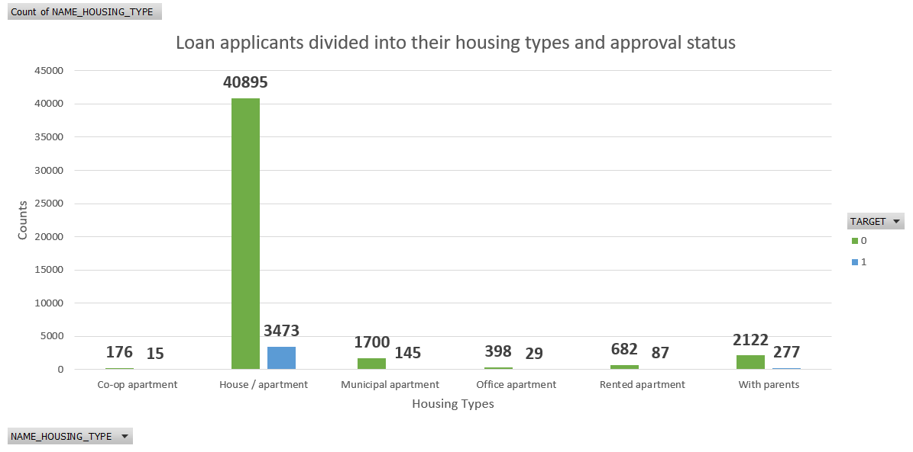
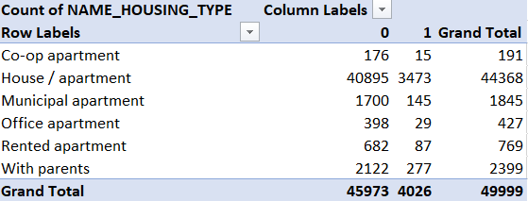
Performing segmented univariate analysis (Cont.)
In the above column graph and pivot table, the loan applicants are divided into their housing types and loan approval status. It can be seen that loan applicants who stay with their parents face the most rejections at 13.05%.

Slide 37
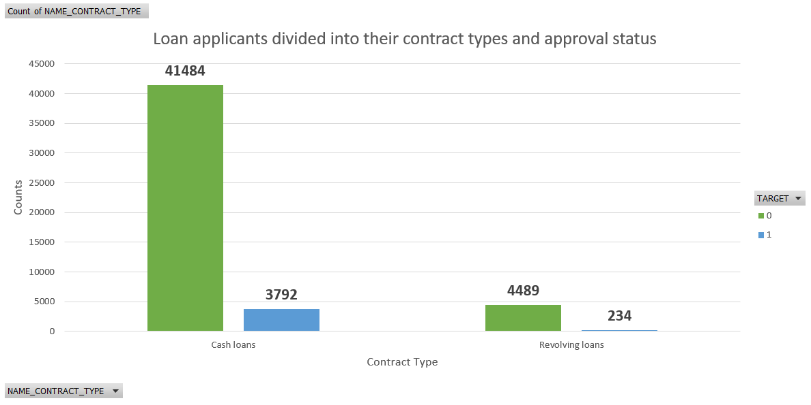
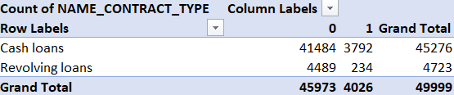
Performing segmented univariate analysis (Cont.)
In the above column graph and pivot table, the loan applicants are divided into their contract types and loan approval status. It can be seen that loan applicants who request cash loans face the most rejections at 9.14%.

Slide 38
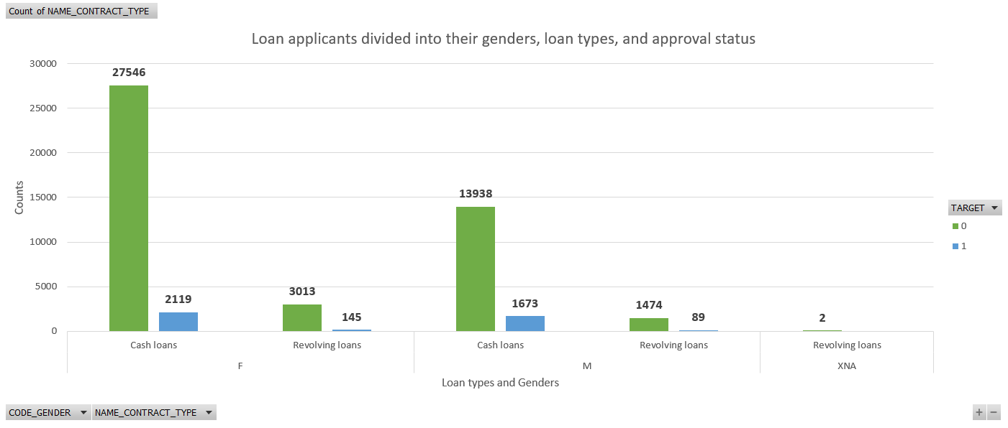
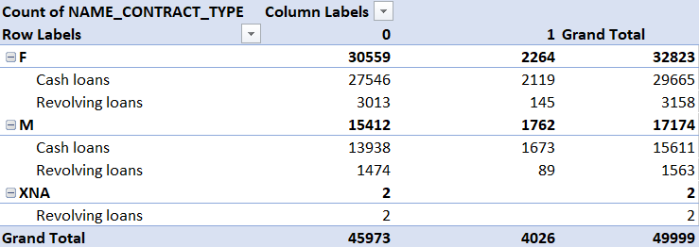
Performing bivariate analysis
In the above column graph and pivot table, the loan applicants are divided into their genders, contract types, and loan approval status. It can be seen that Male loan applicants who request cash loans face the most rejections at 12%.

Slide 39

Performing bivariate analysis (Cont.)

Slide 40
Performing bivariate analysis (Cont.)
In the previous column graph and above pivot table, the loan applicants are divided into their genders, education types, and loan approval status. It can be seen that Male loan applicants with Lower secondary education types face the most rejections at 17.91%.

Slide 41

Performing bivariate analysis (Cont.)

Slide 42
Performing bivariate analysis (Cont.)
In the previous column graph and above pivot table, the loan applicants are divided into their age groups, income types, and loan approval status. It can be seen that Pensioners in the 20-30 age group face the most rejections at 14.28%.

Slide 43
Performing bivariate analysis (Cont.)
The previous examples are only a small subset of the various combinations of bivariate analyses that can be performed from the given dataset. However, for reproduction here in my slide set, I have selected only 3 combinations.

Slide 44

Identifying correlation for various scenarios
In the above table, the correlation between various numeric fields can be seen. It can be seen that a loan applicant’s annuity amount, age, the relative population of the region where the applicant lives, and the no. of inquiries made in the 3 months before the loan application saw correlation at -0.0077.

Slide 45
Result
Based on the insights obtained from the dataset, it can be seen that:
The general success rate of loan applications in this bank is greater than 90%.
Although female loan applicants are more than male loan applicants, the rejection rates for the latter are more than the former.
The most rejection rates are faced by loan applicants who:
Are male
Are in the age group of 20-30
Belong to low-skill laborers’ occupation type
Have a working income type
Possess a lower secondary education
Stay with parents
Request for cash loans

Slide 46
Result (Cont.)
This project has helped me immensely in understanding how a critical function of banks and financial institutions is served through data analysis. It has also provided me clarity on the impact of data in making important decisions within banks and financial institutions that have a wide-ranging effect on the economy.
Dataset link: Final dataset

